Slide 1



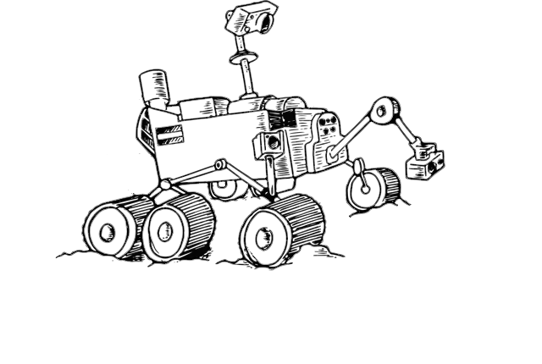
ARMSTRONG
A Rover for Moon SeTtlement Reconnaissance ON Ground
Lorenzo Bolsi Niccolò Glouchtchenko Matteo Nicoli Mathieu Petit
Image credits: NASA Scientific Visualization Studio (background, edited), http://www.welios.at/en/sonderausstellung-schwerelos-ab-11-02-2016/ (rover)

Slide 2
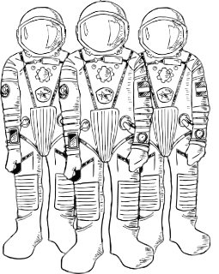
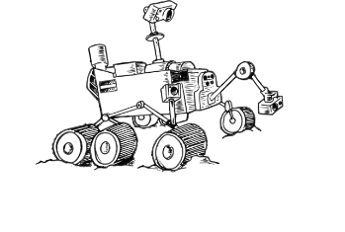

Aims of the Mission
Study the lunar environment to prepare for a future habitat
Long-term mission
Image credits: http://www.icons8.com (moon), http://www.welios.at/en/sonderausstellung-schwerelos-ab-11-02-2016/ (astronauts and rover)

Slide 3
Experiments
Radiation
Effect of the Earth’s orbit around the Sun
Effect of the Earth’s magnetosphere
Shielding effect of the Moon’s regolith
Water-Ice
Surface ice
Establish presence of underground ice
Dust
Long-term damage

Slide 4
Payloads
Radiation
Ionizing Radiation Detector
Drill
Water-Ice
Mass Spectrometer
Drill
Dust
Samples of different materials
Microscope
Solenoid active shielding

Slide 5
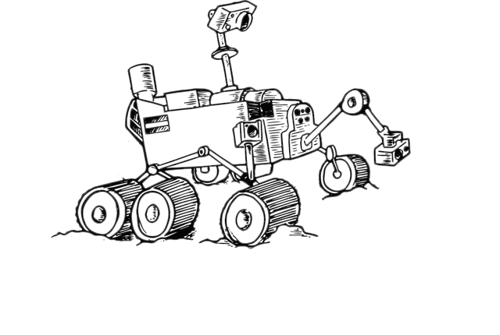
Landing Site
Criteria
Solar exposure
Water-ice presence
Landing area geography

Slide 6

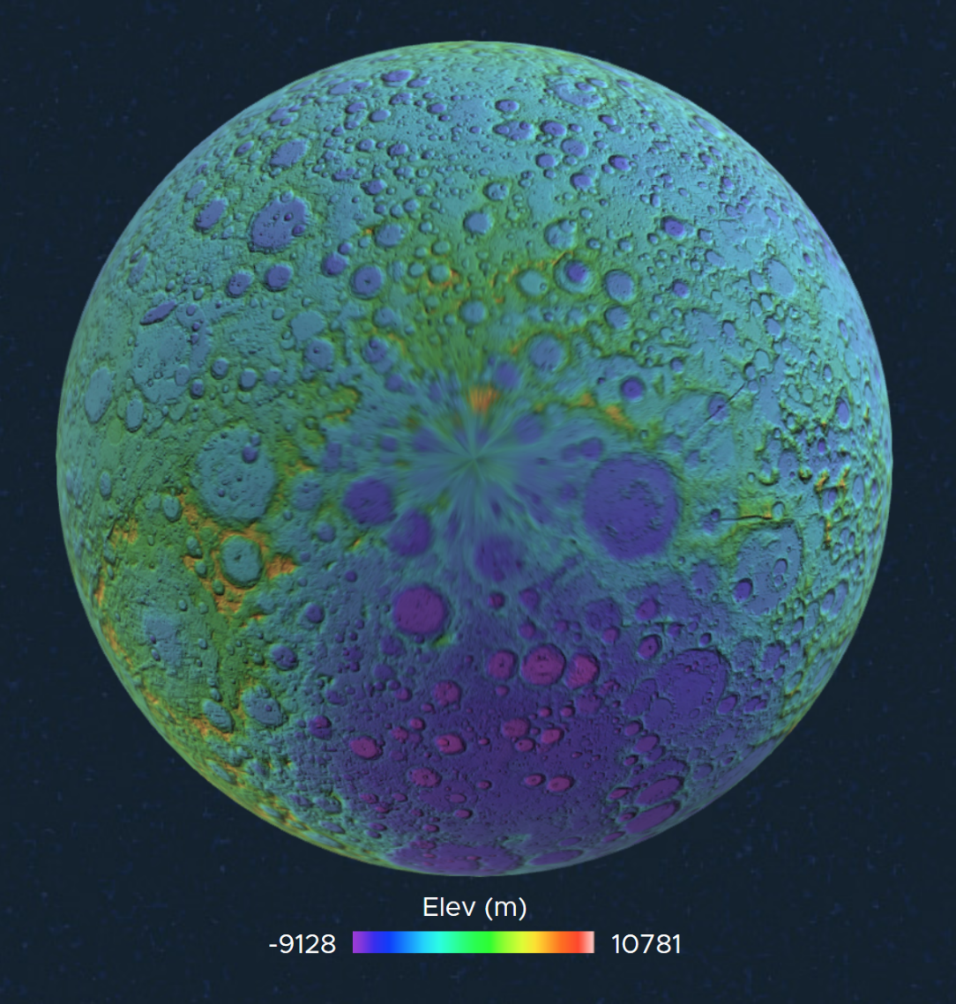
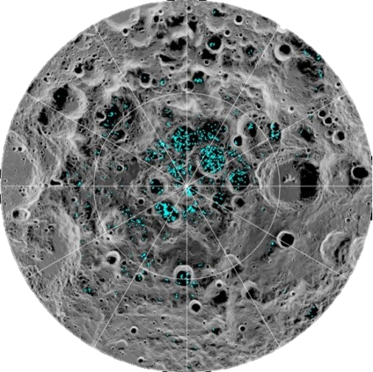








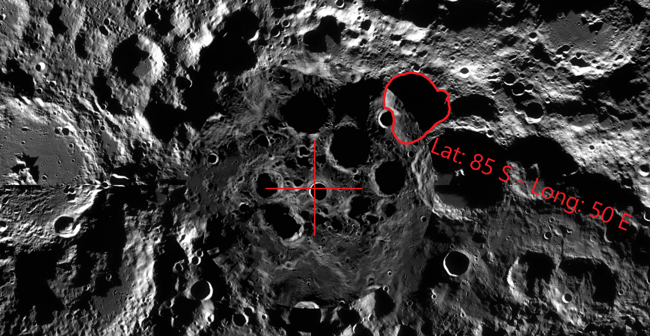
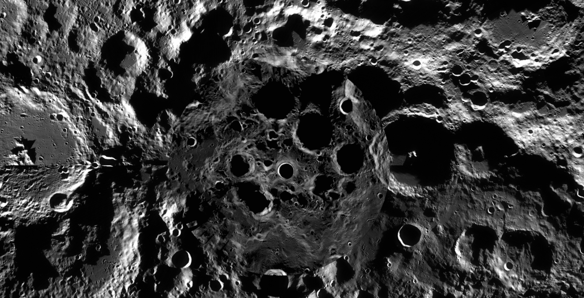
Landing Site
K
Criteria
Solar exposure
Water-ice presence
Landing area geography
Selection
Surface ice
Image credits: NASA moon.nasa.gov
Image credits: NASA
Image credits: NASA moontrek.nasa.gov
Image credits: NASA quickmap.lroc.asu.edu

Slide 7
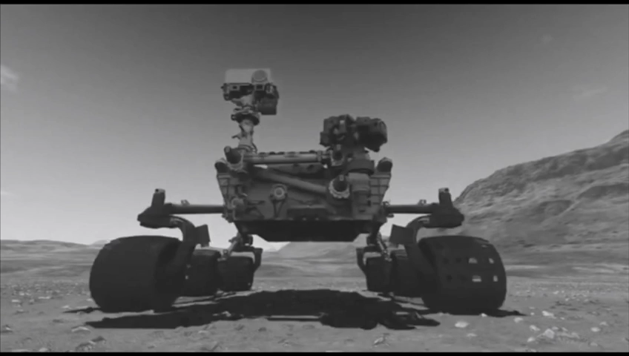
Configuration Considerations
Wheels for mobility
RTGs for EPS and TCS
Assisted landing
Image credits: NASA https://www.youtube.com/watch?v=otNT_Ncnvlg

Slide 8
Thank you for your attention
ARMSTRONG MISSION
https://2018.spaceappschallenge.org/challenges/universe-beauty-and-wonder/mission-mars/teams/armstrong/project

